Slide 1
Sessions 04
Proof of Stake
Blockchain Protocols and Decentralized Applications

Slide 2
Proof of Work
Nodes called miners compete to solve a math problem using brute force
The first miner that solves the problem gets to create a block
Other nodes check if the block is valid
If yes, the miner is rewarded cryptocurrency
If no, the miner wasted their time and energy
All nodes add the new block to their copy of the blockchain
Issues?

Slide 3
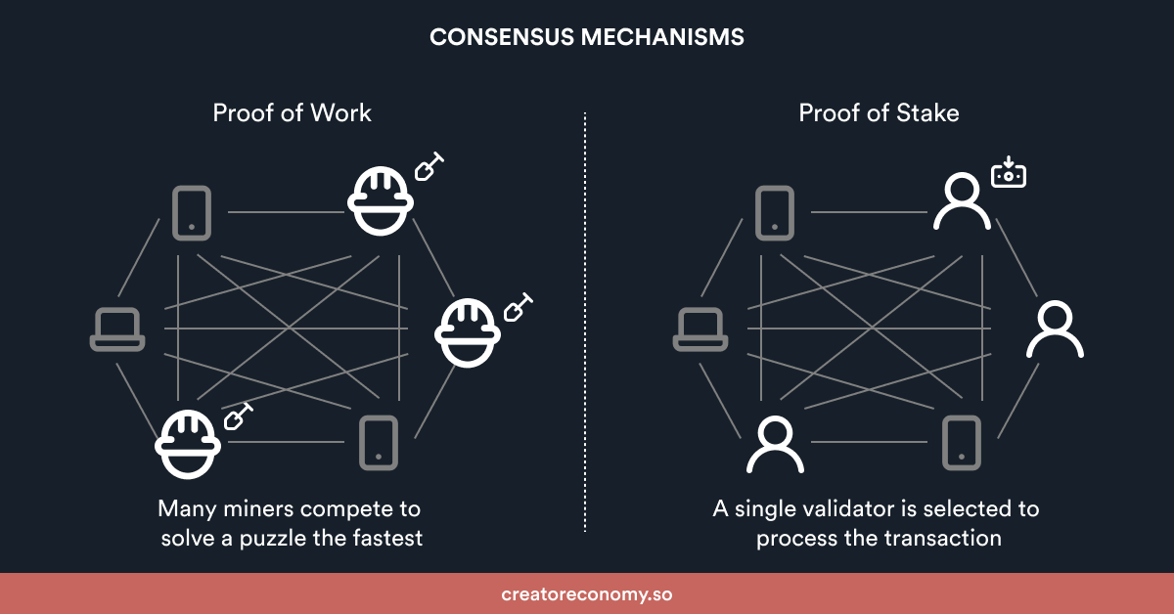
Proof of Work vs Proof of Stake

Slide 4
Proof of Stake
Nodes called validators stake some cryptocurrency
A stake is like saying: “I’ll commit this amount of cryptocurrency to win the right to do this transaction.”
Validators with more stake are more likely (but not guaranteed) to be selected to process the transaction and create a block
Other validators check if the block is valid. If it is, all participating validators earn a transaction fee. If it’s not, the validator that created the block might lose its stake
All nodes add the new block to their copy of the blockchain

Slide 5
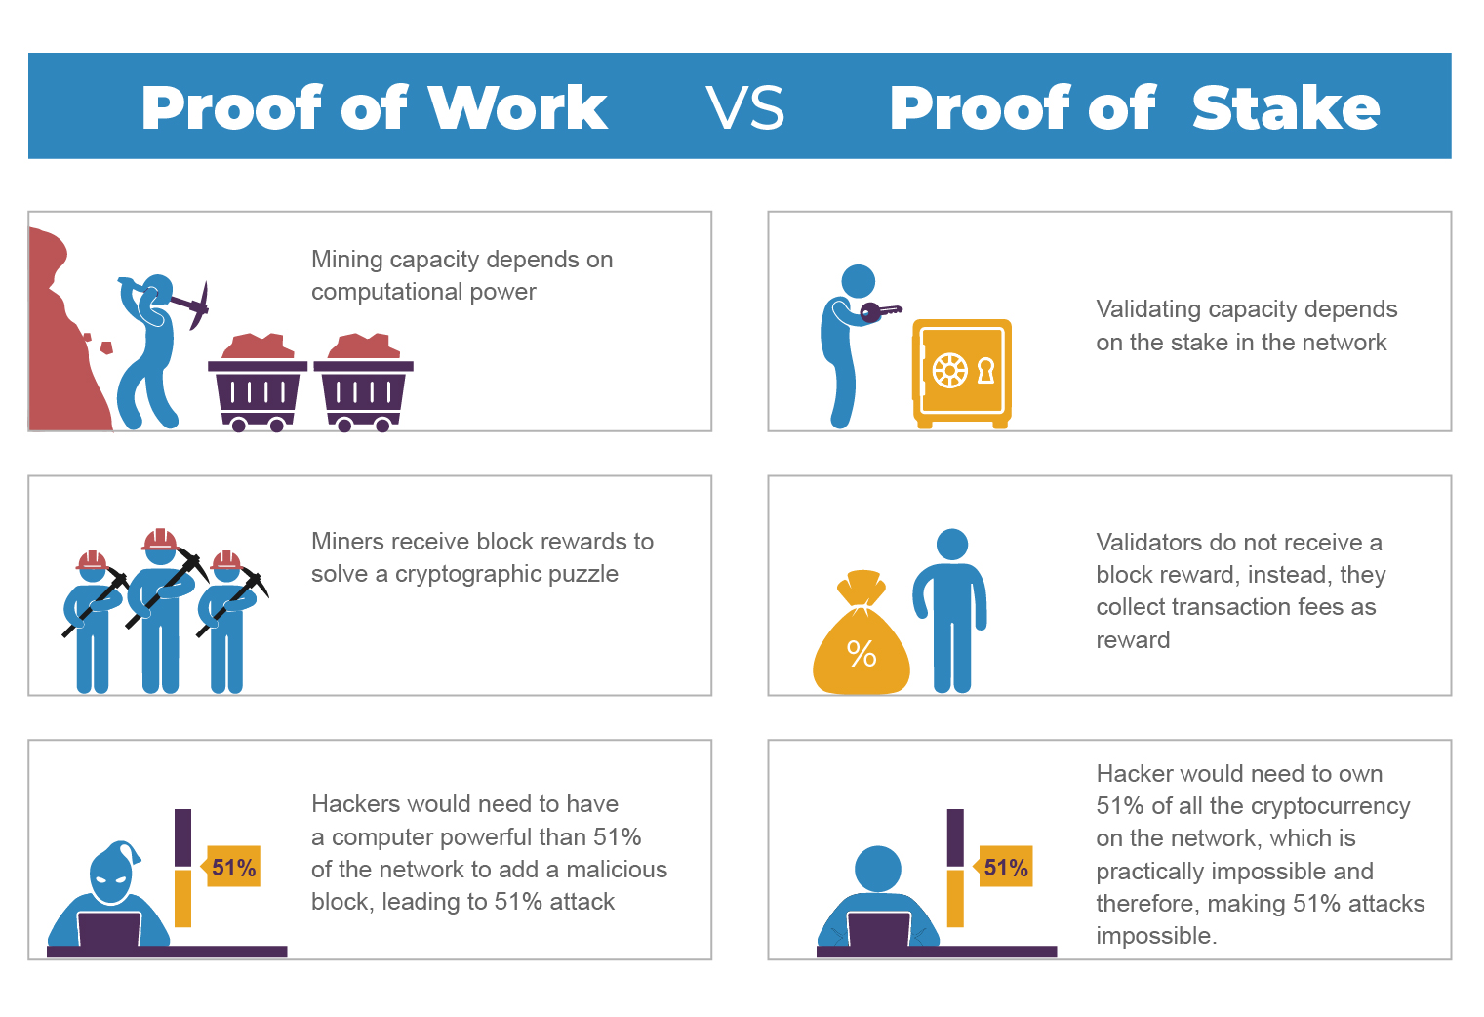
Proof of Work vs Proof of Stake
Source: https://www.leewayhertz.com/proof-of-work-vs-proof-of-stake/

Slide 6
Proof of Work vs Proof of Stake
Participating nodes are called miners
Mining capacity depends on computational power
Mining produces new coins
Miners receive block rewards
Massive energy consumption
Significantly prone to 51% attacks
Participating nodes are called validators
Validating capacity depends on the stake in the network
No new coins are formed
Validators receive transaction fees
Low energy consumption
51% attacks are virtually impossible

Slide 7
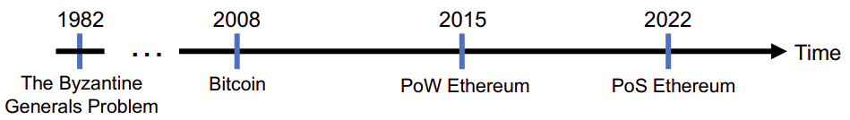
Proof of Stake
Demo - Explorer
https://explorer.multiversx.com/
https://etherscan.io/
Timeline

Slide 8
Transactions
PoW, PoS gives us ..?
Agreement
Bitcoin
Miners come to agreement to move tokens from one user to another
Ethereum
Validators comes to agreement to execute a piece of code

